Slide 1
Genome Assembly and Annotation
Salinibacter ruber
Charles Walker Cano
California State University, Stanislaus

Slide 2
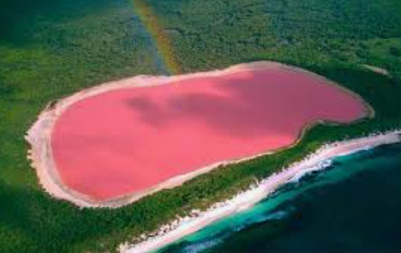
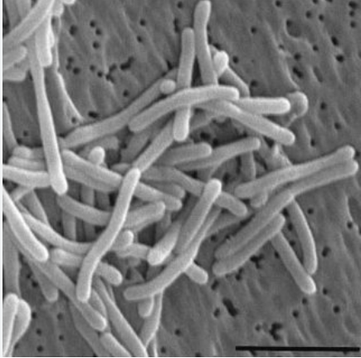
Introduction
Purpose
Assembly reads that are paired ends : + strand and - strand for annotation to look for functions of genes and structures.
Why Salinibacter ruber
Turns Ponds red or pink
Dense communities of Halophilic microorganisms in solution of 30% salt concentration
Notes:
Topic - important to understand the the framework and the overall genetic makeup of an organism which can vary from species and give light to understand the overall function and filling in the map for other genomes

Slide 3
Methods - Assembling genome
Abyss
Used Abyss to assemble genome
Started with pair end reads
Command Interface
Abyss -pe k=96 B=2G in= ’file location’
SPades
Used in galaxy
Same as abyss assembles genome
Notes:
Abyss = calls the program | -pe = pair end reads 5’ to 3’ and 3’ to 5’ | k=98 kaymers = short DNA sequences used to help assemble, can be bigger | B=2G amount of memory used by computer.
2G is just fine for prokaryotic genomes. And in= looks for the reads in the location that you tell it.

Slide 4
Methods - Assembling genome
Major Differences
SPAdes runs well with small to medium sized genomes
ABySS suitable for large scale genome projects.
Notes:
Abyss = calls the program | -pe = pair end reads 5’ to 3’ and 3’ to 5’ | k=98 kaymers = short DNA sequences used to help assemble, can be bigger | B=2G amount of memory used by computer.
2G is just fine for prokaryotic genomes. And in= looks for the reads in the location that you tell it.

Slide 5
Methods - Quality
Quast
Used to examine the overall quality of the genome
Busco
Checks for overall completeness of the genome.
Notes:
It checks for completeness by using BUSCO (Benchmark universal single copy orthologs) This can be done with or without a reference genome.
BUSCO CHECKS FOR GENERAL COMPLETENESS BY USING GENES THAT SHOULD BE PRESENT IN ALL MEMBERS OF THE TAXA

Slide 6
Methods - Annotation
Annotation
Reason for annotating the genome
No sense of assembly the genome if we don’t know what each part of the gene does.
Annotation falls into two categories
Structure
Looks for 1. Promoters 2. Operons 3. Introns 4. Exons 5. Various RNA
What each gene does
Describes and list each identified gene

Slide 7
Methods - Annotation
Two programs that can annotate
Prokka
Ran on command interface
Annotates genes very quickly
Rast
Ran on a web base server
Takes longer vs prokka
My favorite
RAST
Interactive chart that list
Metabolic pathways
Protein encoding genes
Can link different pathways that prokka cannot do

Slide 8
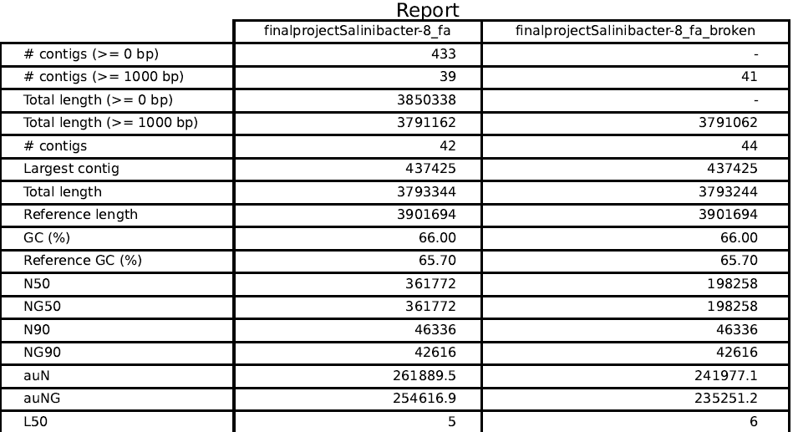
Results - Quality Abyss
Notes:
N = total number of contigs | L50 = number of contigs needed to make up 50% of the genome | N50 = measurement of the contiguity of the assembly. The length of the smallest contig in the set of the longest contig together make up at 50% of the genome assembly.

Slide 9
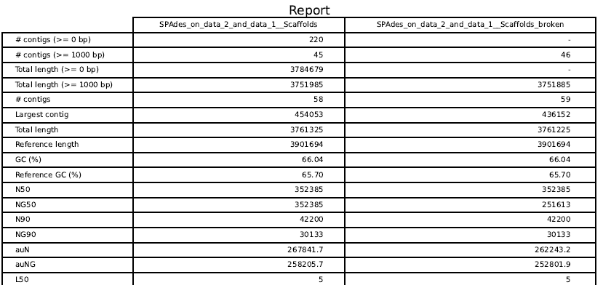
Results - Quality SPAdes
Notes:
GC content reveals resistance to heat and less energy cost to synthesize proteins prevents protein denaturization

Slide 10
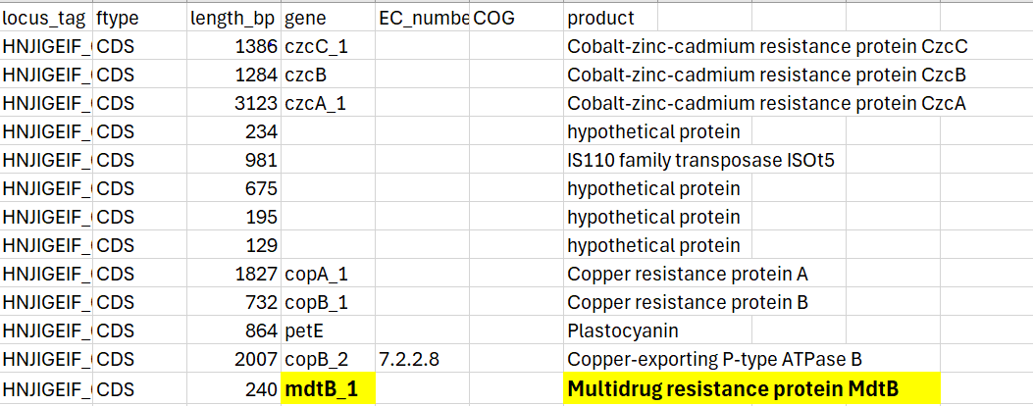
Results - Annotation Prokka

Slide 11
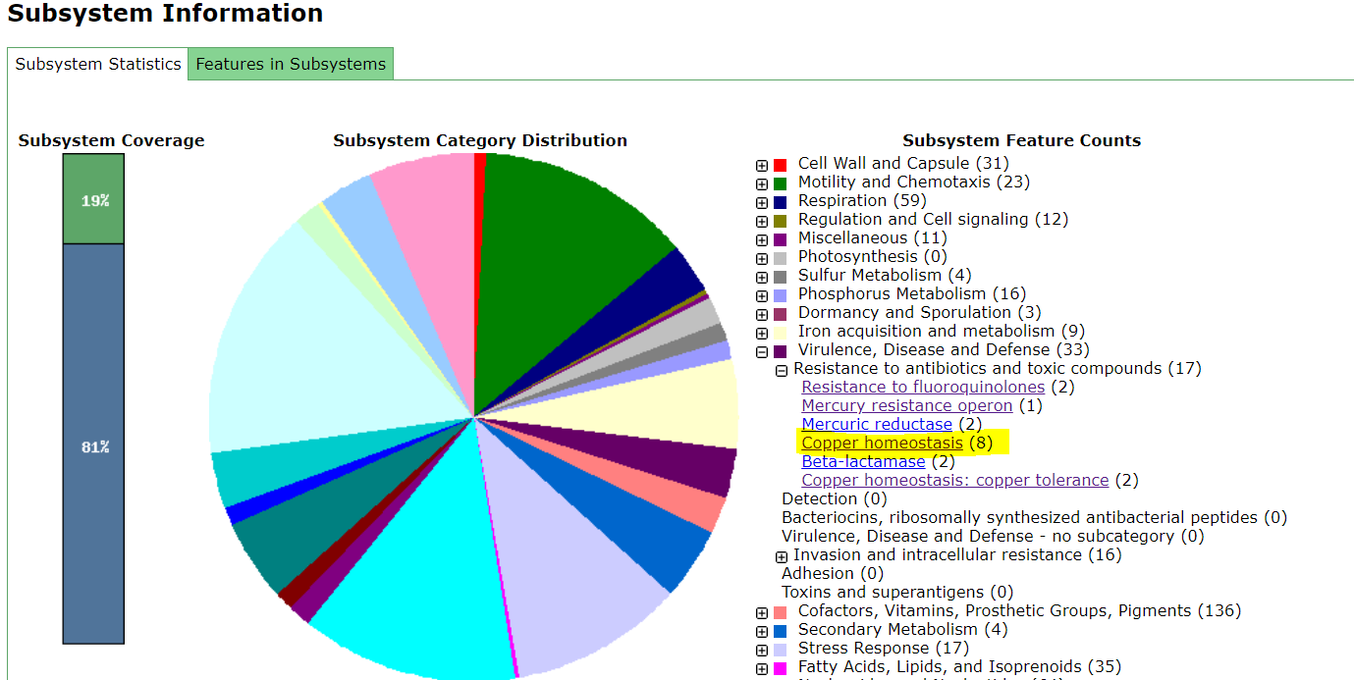
Results - Annotation RAST
Virulence, Disease and Defense
8 defenses for Copper
why?

Slide 12
Results - Annotation RAST
CuSO4 used in pond water in spain where Salinibacter rubus was discovered (Leon, et al. 2014)

Slide 13
Conclusion
Previously stated why assemble a genome if you don't know what each part of genome does.
This is why programs such as prokka and RAST are important
If you are a visual learner
RAST allows to visualize functions like I was able to do with the copper defense that my bacteria has.

Slide 14
Reference
Leon, David & Peñalver, Patricio & Casas, J. & Juan, Melchor & Fuentes-Rodríguez, Francisca & Gallego, Irene & Toja, Julia. (2014). EFFECTS OF COPPER SULPHATE ON ZOOPLANKTON COMMUNITIES IN PONDS SUBMITTED TO AGRICULTURAL INTENSIFICATION. Boletín de Biodiversidad de Chile. 2014. 1-10.

